Slide 1
Stress Effects on Statistical Learning
November 4, 2019

Slide 2
Statistical Learning
Statistical Learning = the ability of the brain to extract statistical regularities to learn generalizable rules about the environment
Traditional memory models suggest that this is supported mainly by the cortex
Recent studies demonstrated that the hippocampus can play a role in rapid statistical learning
Temporal communities are predictable relationships about which stimuli are likely to co-occur
Temporal communities can be used implicitly in event segmentation
Shapes with statistical relationships had more similar patterns of activation in fMRI
The hippocampus was necessary for the formation of community representations

Slide 3
Stress and the Hippocampus
Stress impacts a variety of medial temporal functions
Supportive of generalization during encoding
Often obstructive during retrieval
Can induce need for further evidence accumulation
Predictions
Increased performance for encoding group
Decreased performance for retrieval group
Increased lag in response time for the retrieval group
Notes:
Screen capture of the task

Slide 4
Study Goals
Quantify whether and how acute stress impacts statistical learning
Quantify the relationship between performance on temporal community learning tasks and individual differences
Evaluate the relationship between conscious awareness of statistical relationships and demonstrated implicit learning

Slide 5
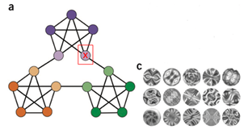
Methodology
Statistical Learning Task
Learning Phase: Subjects see a series of 1400 abstract stimuli, following statistical rules
Retrieval Phase: Subjects see another series of 600 shapes, following the same rules. They are asked to press the spacebar when they feel there is a “natural breaking point” in the sequence
Conscious Awareness Task
Stress Induction Procedure
Salivary Cortisol Measures

Slide 6
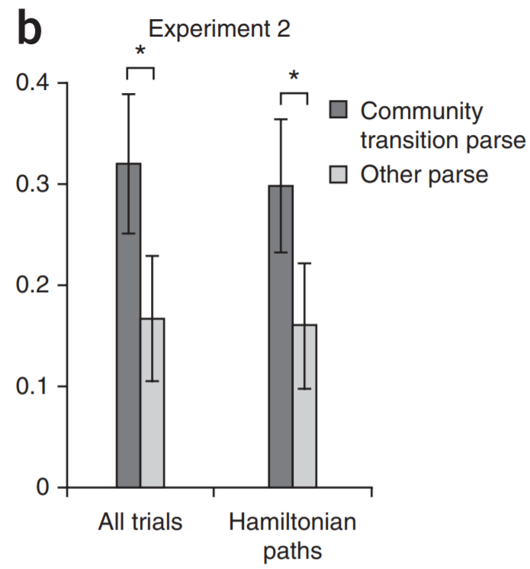
Original study defined statistical learning by measuring what proportion of the time participants “parsed” between communities versus for other shapes
Expand that definition by examining “lag” parses

Slide 7
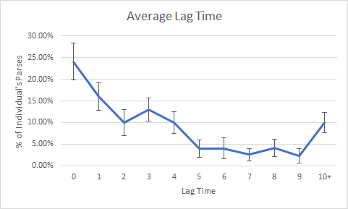

Slide 8
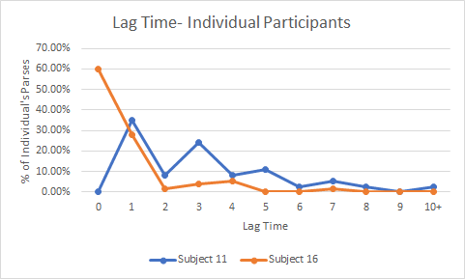

Slide 9
Other Analyses
Examining shape preferences
Is there an overall preference for a particular shape?
Is there edge sensitivity?
Significant variability in individual responses
Some participants show response reluctance/low response rates
Some participants respond equally to community transitions and other shapes
Some participants respond significantly more to transitions than other shapes
No relationship found between conscious awareness and implicit learning performance

Slide 10
Next Steps
Continue collecting control sample, to set cutoffs for response rates
Transition to collecting stress group data
Look for predictors of performance to discriminate between individuals and between groups
Shape preference
Lag times/evidence accumulation
Current stress levels
Accuracy on the masking task
Etc...

Slide 11
References
1. Schapiro, A. C., Rogers, T. T., Cordova, N. I., Turk-Browne, N. B., & Botvinick, M. M. (2013). Neural representations of events arise from temporal community structure. Nature neuroscience, 16(4), 486.
2. Schapiro, A. C., Turk-Browne, N. B., Botvinick, M. M., & Norman, K. A. (2017). Complementary learning systems within the hippocampus: a neural network modeling approach to reconciling episodic memory with statistical learning. Philosophical Transactions of the Royal Society B: Biological Sciences, 372(1711), 20160049.
3. Schapiro, A. C., Gregory, E., Landau, B., McCloskey, M., & Turk-Browne, N. B. (2014). The necessity of the medial temporal lobe for statistical learning. Journal of cognitive neuroscience, 26(8), 1736-1747.
4. Gagnon, S. A., Waskom, M. L., Brown, T. I., & Wagner, A. D. (2018). Stress impairs episodic retrieval by disrupting hippocampal and cortical mechanisms of remembering. Cerebral cortex (New York, NY: 1991).

